Slide 1
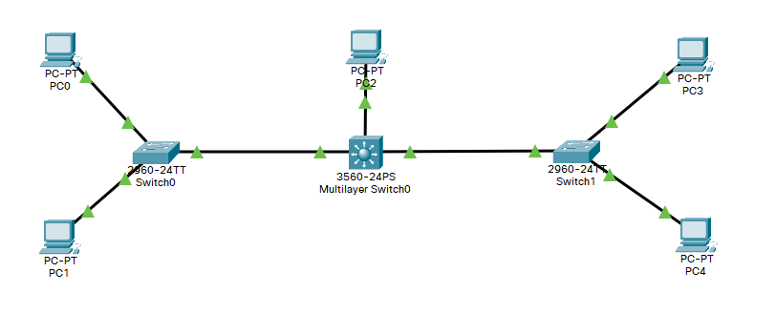
VLAN 10
Net 192.168.10.0
Access port
Trunk ports
Trunk ports
Access ports
Access ports
VLAN 20
Net 192.168.20.0

Slide 2
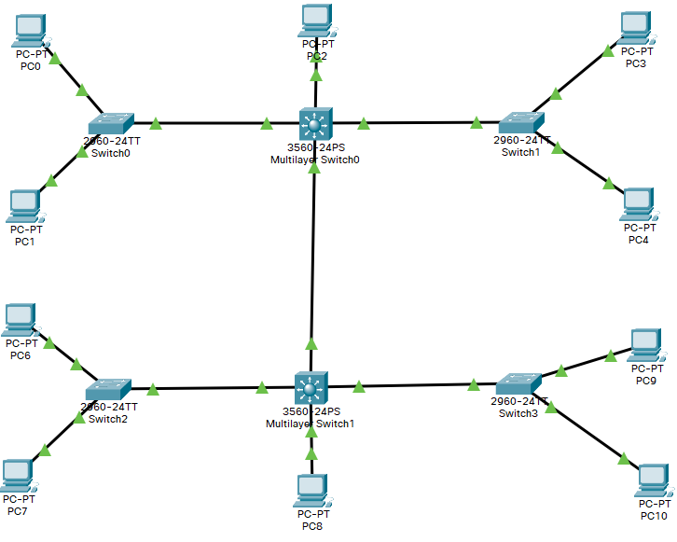
VLAN 10
192.168.10.0
VLAN 20
192.168.20.0
VLAN 30
192.168.30.0
VLAN 40
192.168.40.0

Slide 3
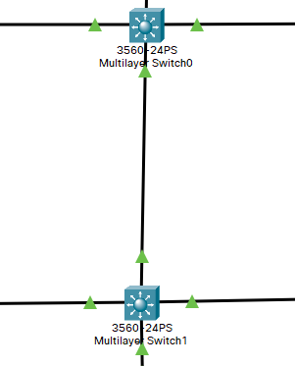
192.168.100.1
Network
192.168.100.0
192.168.100.2

